Slide 1
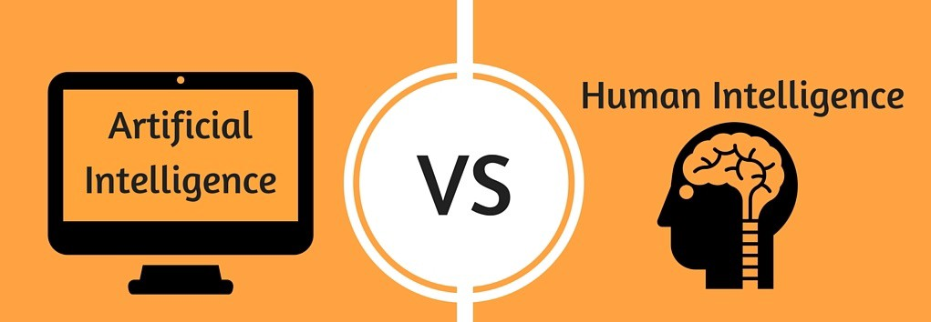

Artificial intelligence vs Human intelligence
Leonardo Pedro

Slide 2
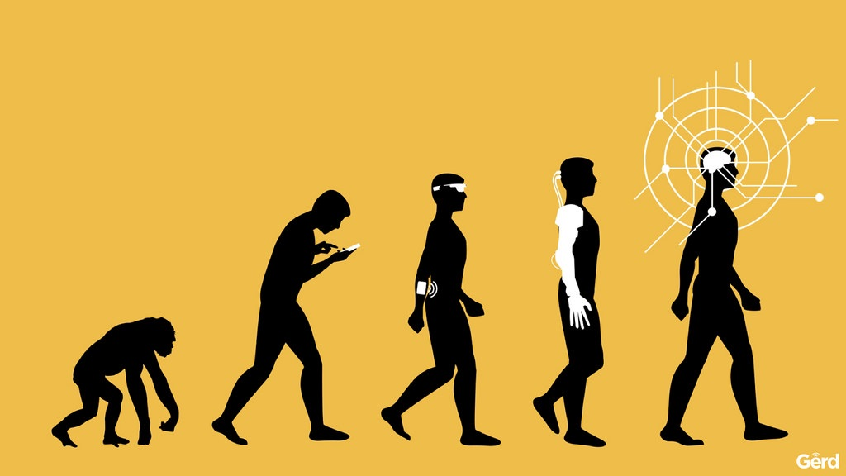
Intelligence
Reasoning
Problem-solving
Learning
Perception
Attention
Memory
Language
Planning

Slide 3

Artificial intelligence
Knowledge
Reasoning
Problem solving
Perception
Learning
Ability to manipulate and move objects
Planning

Slide 4

Human intelligence
Learn from experience
Adapt to new situations
Understand and handle abstract concepts
Use knowledge to manipulate one’s environment.

Slide 5
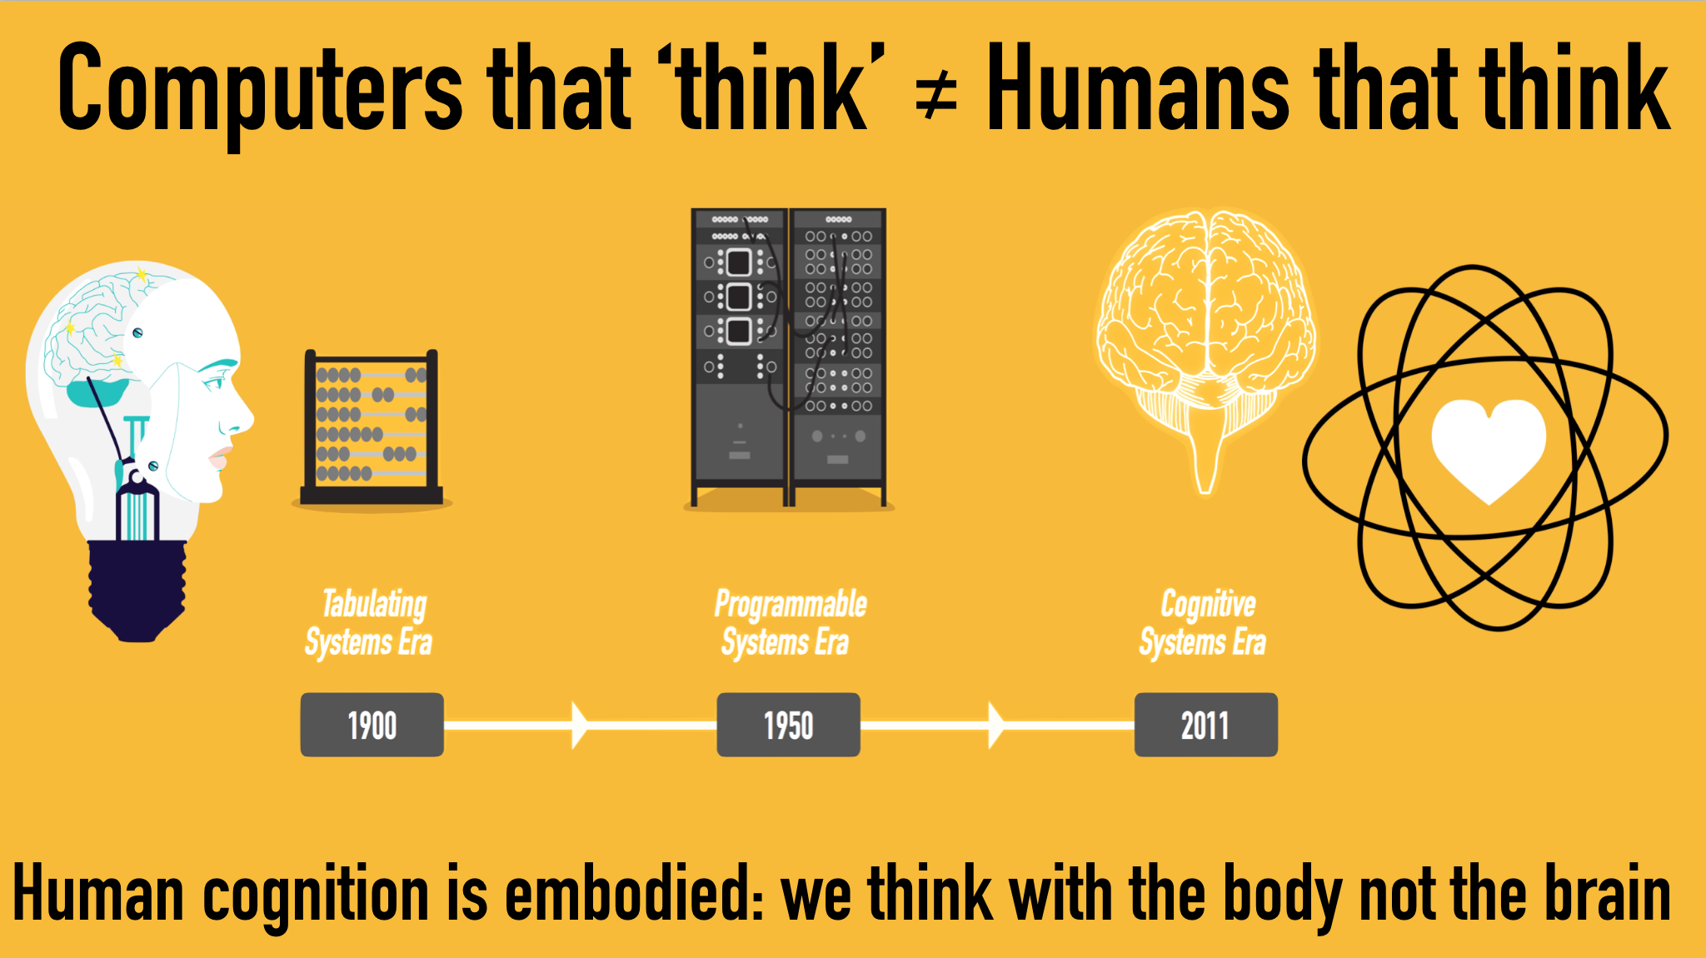
Key Differences
Nature of Existence
Memory usage
Mode of creation
Dominance

Slide 6


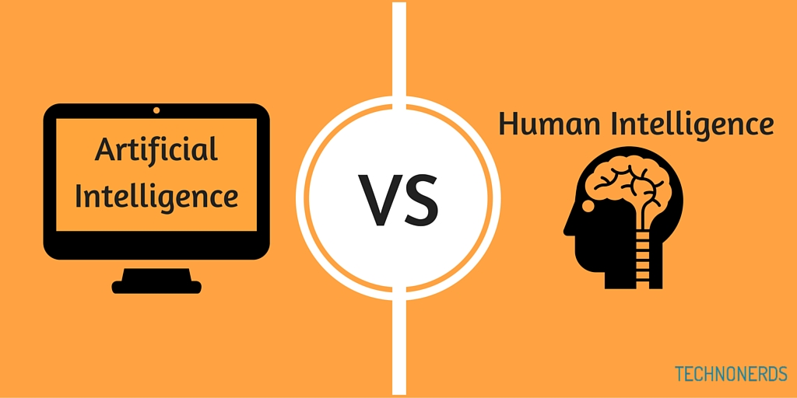

WHICH ONE WINS?

Slide 7

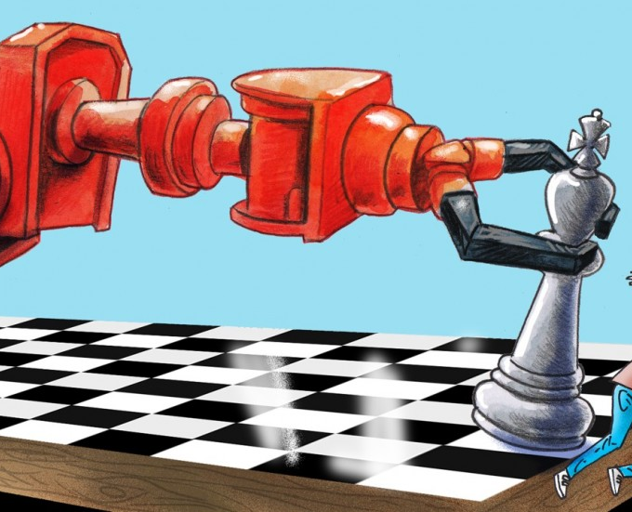
Advantages of Artificial Intelligence
Speed of execution
Operational Ability
Accuracy

Slide 8

GERD LEONHARD

